Slide 1
Data Analytics
Presented by –
Aditya Gaikwad – 71
Tejas Mahakalkar – 76

Slide 2

Introduction
The main objective is to demonstrate how KNIME can simplify the entire data analysis workflow — from data cleaning and preprocessing to clustering and visualization — without the need for programming. By applying techniques like K-Means clustering and generating insightful visualizations, the project uncovers key customer segments and regional sales trends, helping to drive smarter business decisions.

Slide 3
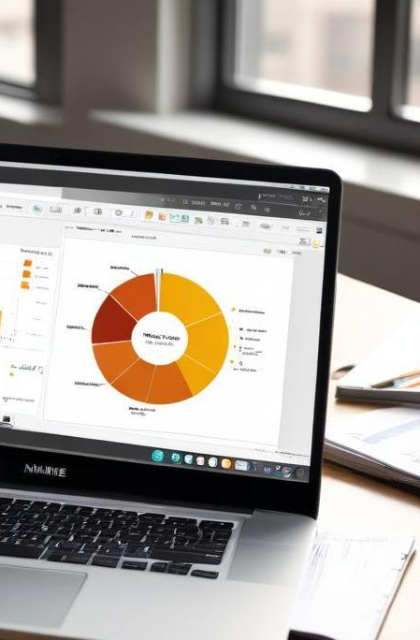
01
KNIME Overview

Slide 4
What is KNIME?
KNIME (Konstanz Information Miner) is a free and open-source data analytics, reporting, and integration platform that lets users create data workflows visually without coding . It combines tools for data analysis, machine learning, and data mining, making it useful for both beginners and experienced data scientists across different industries.

Slide 5
Advantages of KNIME
No coding required – easy drag-and-drop interface
Free and open-source platform
Great for beginners and professionals
Supports data cleaning, analysis, and machine learning
Integrates with Excel, Python, SQL
Built-in tools for charts and data visualization
Excel, Python, SQL, and more
Built-in tools for charts and data visualization

Slide 6

Using KNIME to Analyze and Visualize Netflix Data
The dataset contains details like title, rating, content advisory, release year, and user ratings. Using KNIME, we clean and organize this data to uncover trends in viewer preferences and content popularity. Clustering techniques group shows by release year and rating behavior to analyze category performance. Visualizations highlight top-rated content, rating trends, and viewer segments, offering insights to guide smarter content strategy decisions.

Slide 7

02
Data Processing

Slide 8
Data Preparation
Removed unnecessary columns to focus on relevant data
Identified and filled missing values to ensure data integrity
Converted string values to numeric types for processing
Normalized numerical values to improve clustering accuracy
Filtered out duplicates for a leaner, more reliable dataset
Formatted date fields for better time-based analysis

Slide 9

Data cleaning techniques applied
Column Filtering
Missing Value Treatment
Data Type Conversion
Normalization
Duplicate Removal
Date Formatting
Data Consistency Check

Slide 10
Clustering and visualization methods
The K-Means clustering algorithm was applied to the cleaned retail sales dataset to identify meaningful customer segments based on features like sales amount and regional distribution. This helped in grouping customers with similar purchasing behavior. Visualization techniques such as scatter plots were used to represent the formed clusters clearly, while bar charts highlighted sales performance across different regions. These visual tools made it easier to understand patterns and uncover actionable business insights.

Slide 11
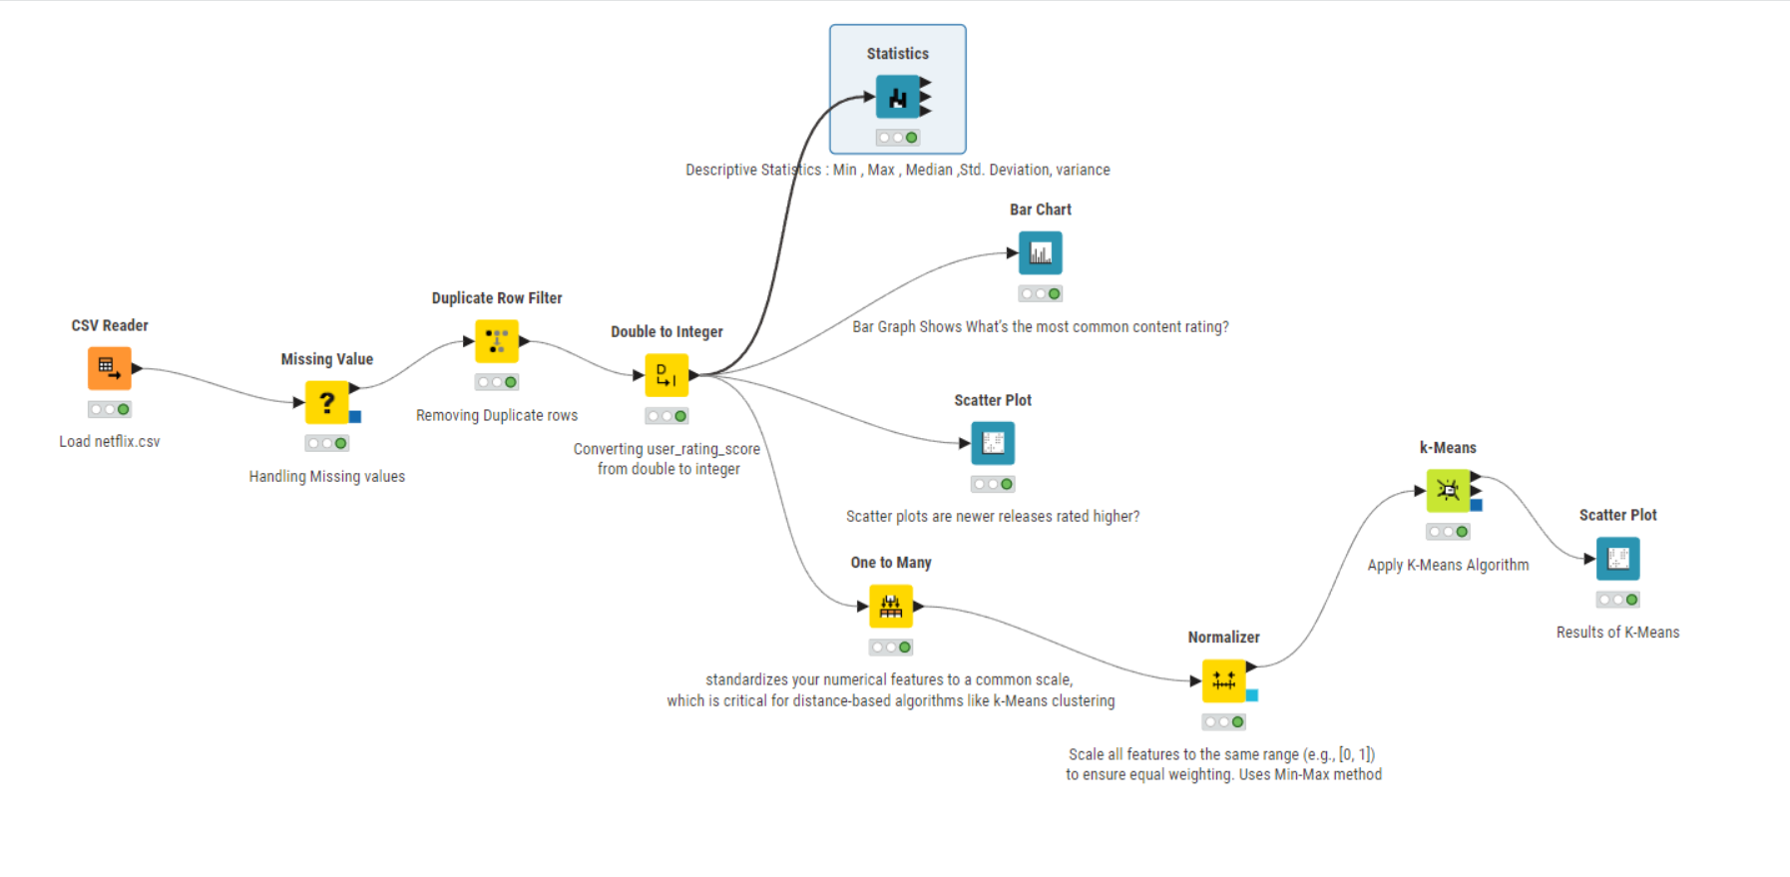

Slide 12
Conclusion
KNIME proves to be a powerful and user-friendly platform for data analytics, especially for users with little to no programming experience. It streamlines ETL processes and enables quick implementation of advanced techniques like clustering and visualization. KNIME can uncover valuable insights from retail sales data efficiently, making it a great tool for both academic learning and real-world applications.

Slide 13
Thank you!
Do you have any questions?

